Slide 1

File transfer and chat app

Slide 2

DEPARTMENT OF INFORMATION SCIENCE & ENGINEERING
“FILE TRANSFER AND CHAT APP”
COURSE NAME : MINI PROJECT
COURSE CODE:19ISE49
Presentation by,
NAME :PUNITH KUMAR S
USN : INH18IS079
Under the Guidance of ,
Guide Name :ANANDHI
Designation:

Slide 3
Agenda
Introduction
Liretarature survey / Existing system
Limitations of Existing System
Problem Definition
Objectives
Design modules
Algorithm / Flow chart
Conclusion

Slide 4
Introduction
File transfer and chat app is a project used to send files from one server to client and with the same client server we can also start chatting with them. It is developed as app so that can be user friendly

Slide 5
Liretarature survey / Existing systems
The existing system is the app with Wifi hotspot but this app is Wifi-Direct.
This app includes both file transfer and chatting with the client by wifi-Direct without other necessary it can be easily transfered and returned to client.

Slide 6
Limitations of Existing Systems
This project is used for sharing any important files and chat with them. The existing system don’t has both system in one app so this app connect with client and can do both chat and transfer of files.

Slide 7
Problem Definition
To start a connection with client server and start transferring the files and chat with them.
The files and chat messages can be transferred to the selected clients without any errors .

Slide 8
Objectives
To make easy connection between the users.
To transfer all types of files within a short duration.
Friendly chatting without data.
This application is totally secure for the users. Only if the receiver has the key he can decrypt the ciphered message to the correct message.

Slide 9
Design Modules
Initialsie()
Connect()
Discover_peers()
Cancel_connect()
Removegroup()

Slide 10
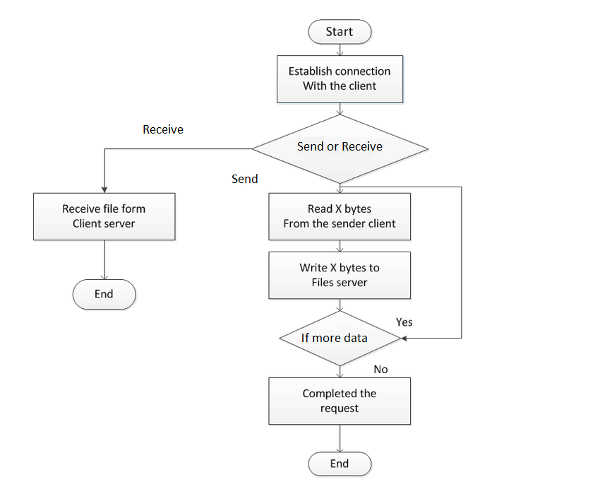
Algorithm / Flowchart

Slide 11
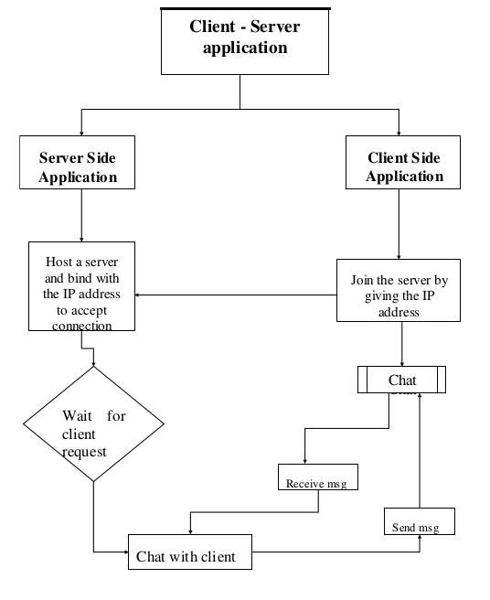

Slide 12
Conclusion
This file transfer and chat project in android studio can be successfully operated in real environment and can be tested practically.
The files and chat messages can be sent to the selected clients.
All the activities provide a feeling like an easy walk over to the user who is interfacing with the system.

Slide 13
References
[1] Textbook
[2] Journal / conference paper
[3] White paper
[4] Articiles / news
[5]web links

Slide 14
Thank you

